Slide 1
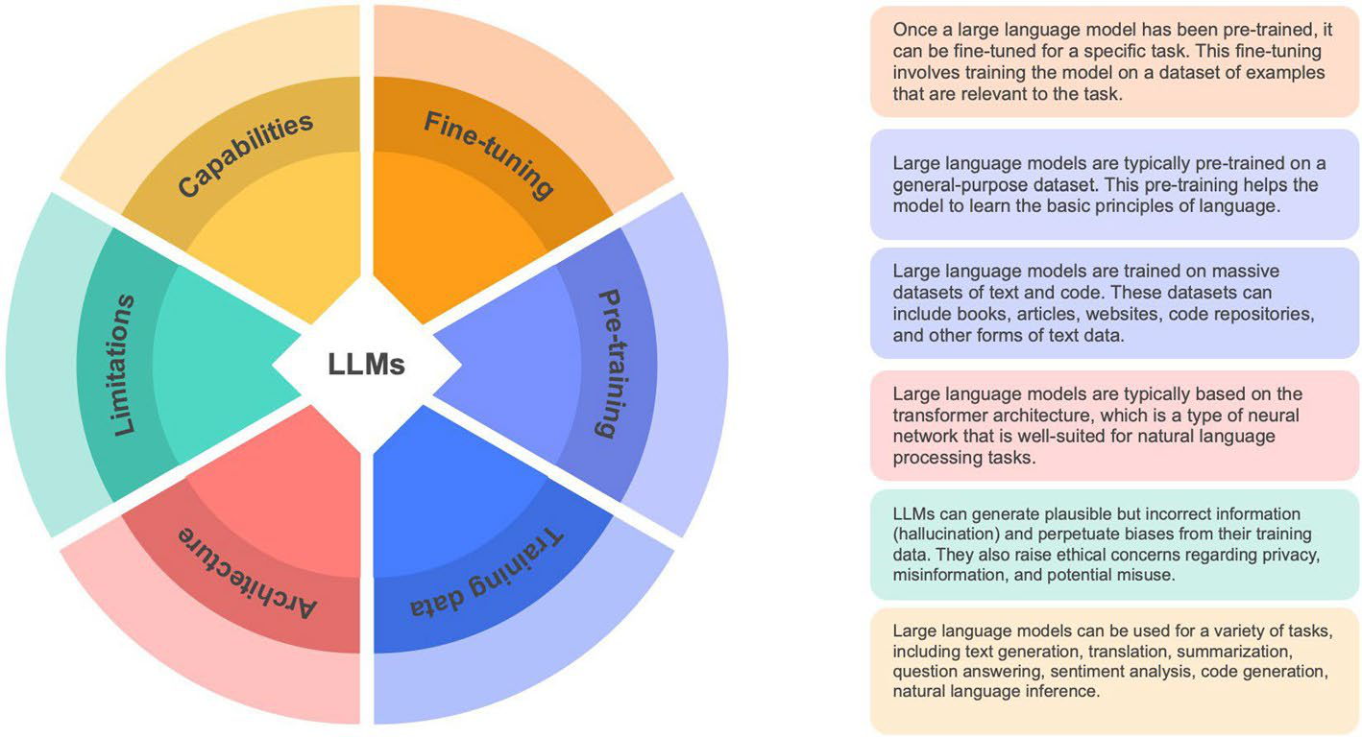
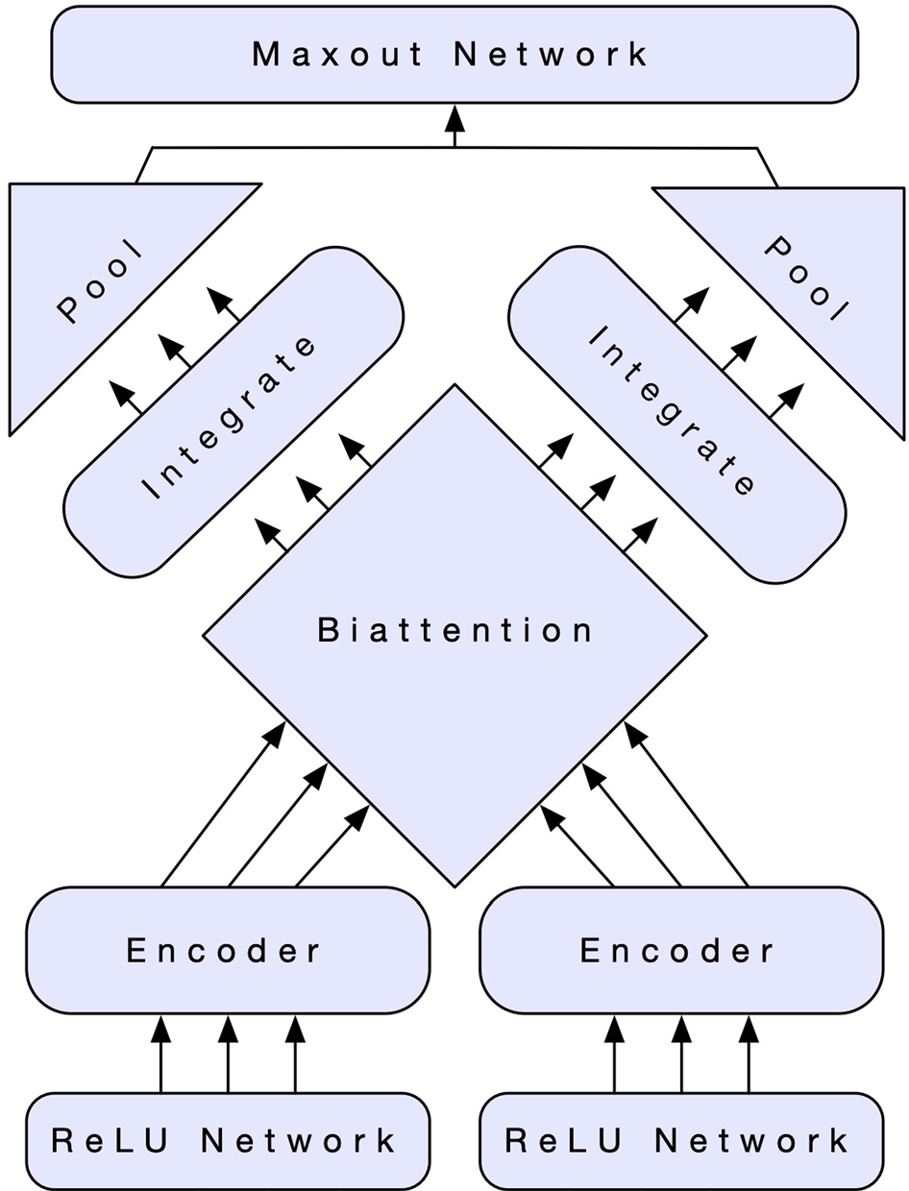
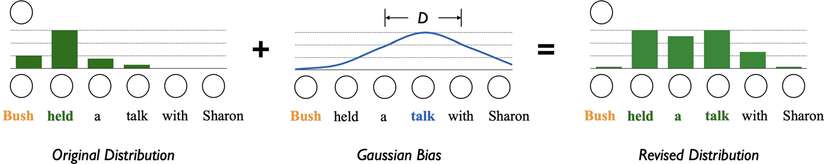
Llms conventional language models
• Training and inference of LLMs require considerable computational resources
• Progress in LLMs has been achieved by improving pre-training techniques and expanding training datasets
• Pre-trained language models (PLMs) have become prevalent since the late 2010s
• PLMs learn universal language representations from extensive data
• The advancement of LLMs depends on the availability of pre-trained datasets

Slide 2
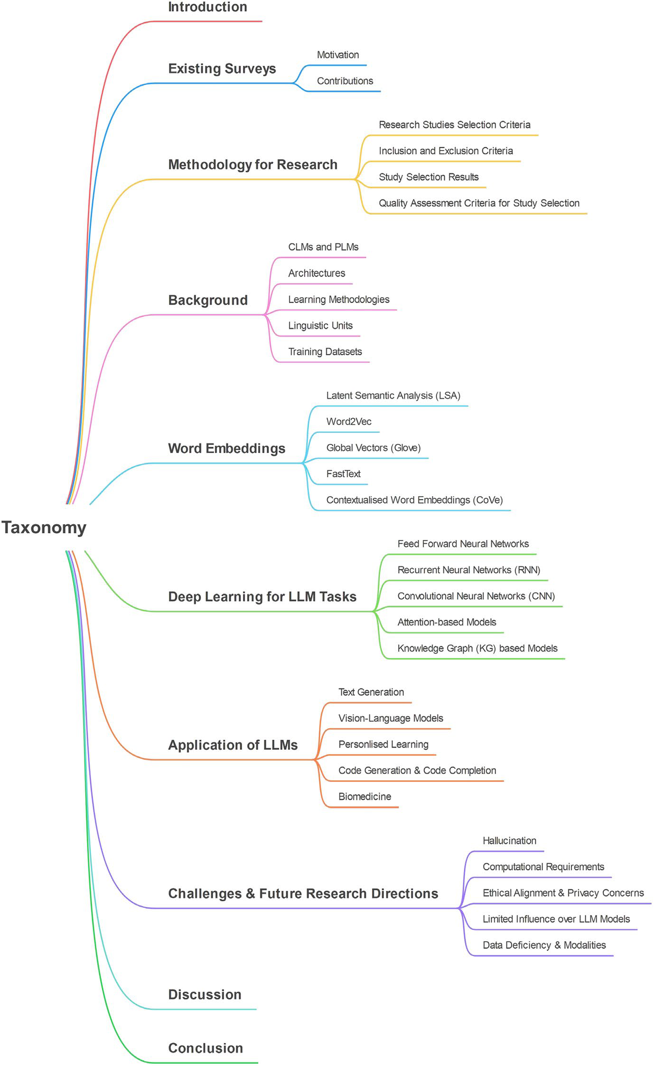
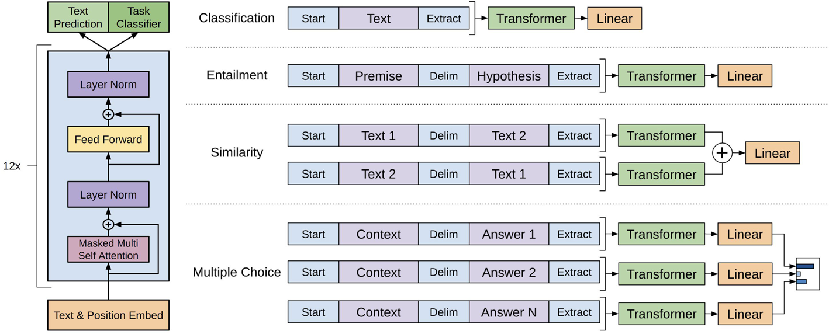
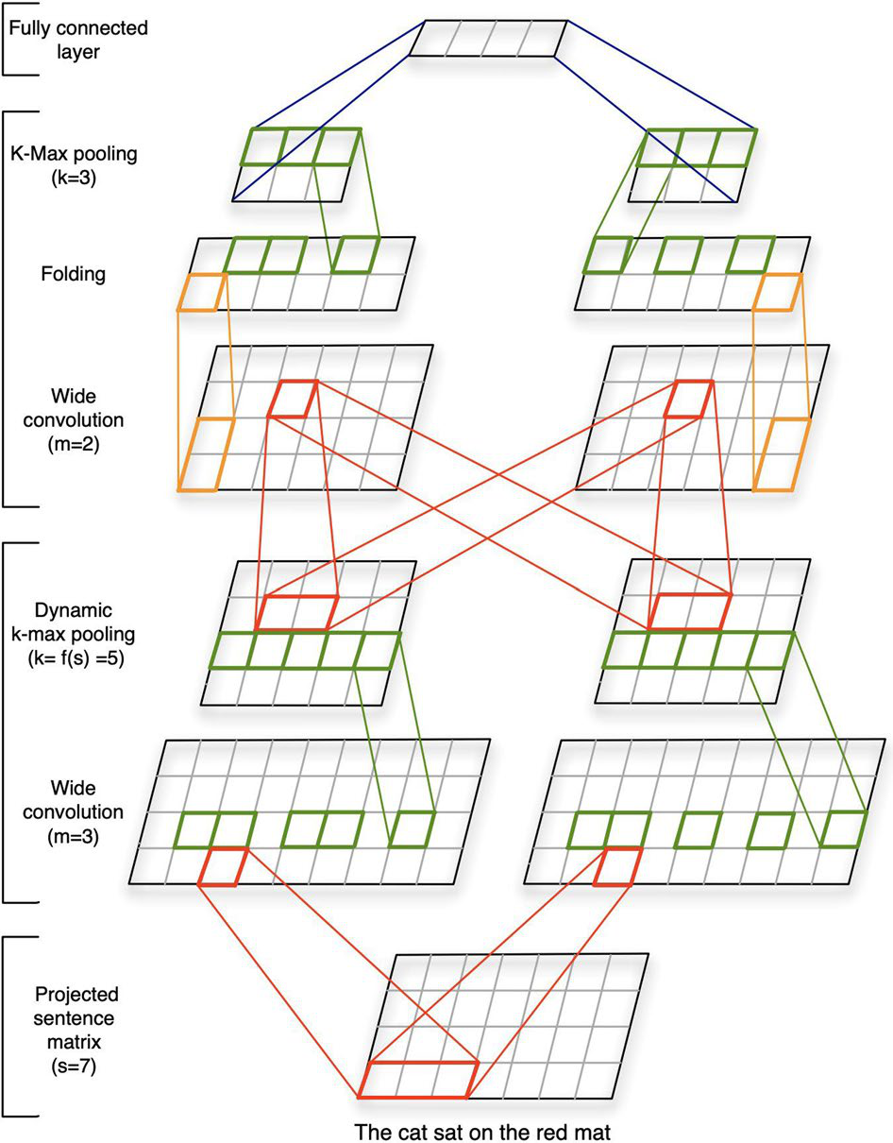
Language model employs deep
• The document analyzes challenges related to language models
• Tokenization techniques like Byte-Pair Encoding (BPE) and Unigram Language Model (ULM) are used to create vocabularies for language models
• Tokenization involves breaking text into tokens, which are fundamental components for language models
• The research focuses on established methodologies and may not include recent developments in language models

Slide 3
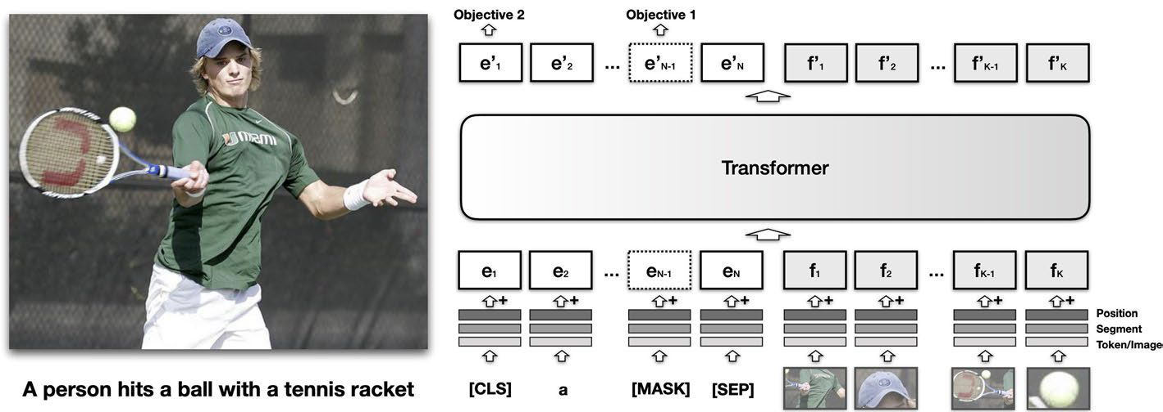
Nlp tasks llms
• LLMs can improve their functionalities
• LLMs are complex and their architecture is inaccessible, which limits their benefit from certain methods
• PLMs can generate text independently
• Text generation is a key application of LMs
• Reformulating tasks as text generation can help apply LLMs to address them efficiently

Slide 4
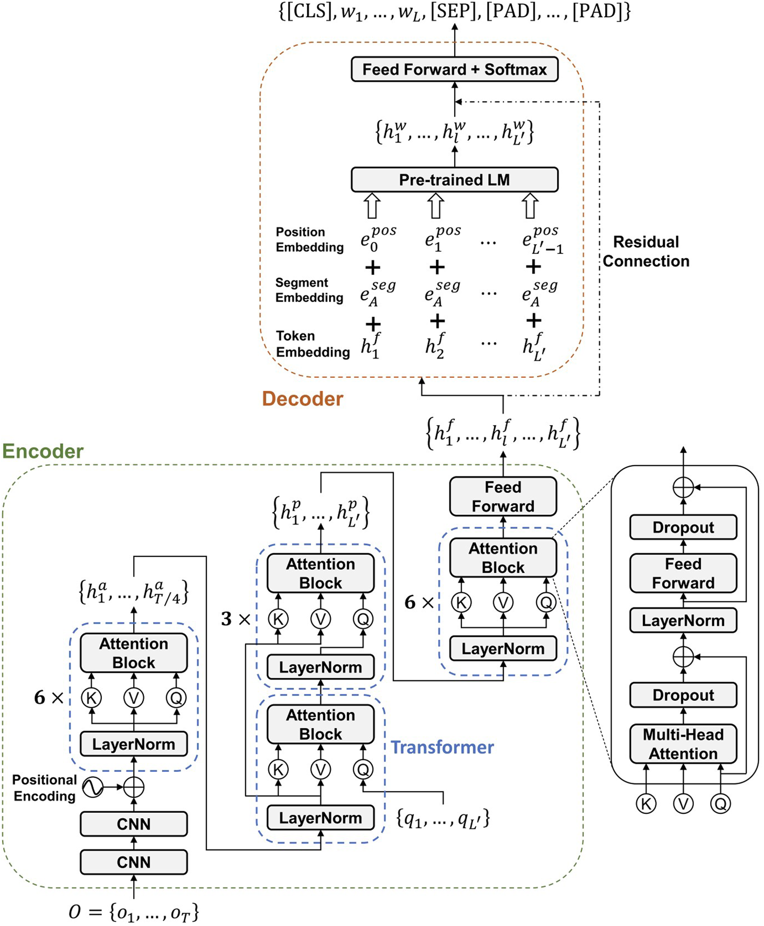
Provided large language models
• The document section examines Transformer-based language models
• Language models require significant computational resources for training and inference
• Vocabulary construction often uses techniques like Byte-Pair Encoding (BPE) or Unigram Language Model (ULM)
• Fine-tuning with custom datasets and objectives is used for specific applications
• Language models are trained on extensive textual datasets and can perform various language processing tasks

Slide 5
2018 large language models
• Large Language Models (LLMs) are pushing boundaries, but issues exist regarding their implementation
• Concerns include improper use, unethical implementation, and compromised integrity
• Research primarily focuses on established methodologies and might not include recent developments
• Transformer-based language models are examined
• Further development is needed for LLMs to reach their full potential, alongside ethical guideline establishment

Slide 6
Improves large language models
• Large Language Models (LLMs) face challenges including improper use, unethical implementation, and compromised integrity
• LLMs can generate text that seems plausible but contains incorrect or inappropriate information
• LLMs are often fine-tuned with specific datasets and objectives for their intended applications
• The research may focus on established methodologies, potentially overlooking recent developments

Slide 7
Large language models
• Training and inference of Large Language Models (LLMs) require significant computational resources
• The document examines Transformer-based language models
• Tokenization techniques like Byte-Pair Encoding (BPE) and Unigram Language Model (ULM) are used for vocabulary construction
• Various tokenization strategies have unique advantages and disadvantages
• The document touches on language models used for code generation

Slide 8
Nlp ai models
• The text provides an overview of Large Language Models (LLMs) within the context of Natural Language Processing (NLP)
• It highlights the progression of NLP and AI models, including the initial challenges and advancements
• The text mentions the use of neural networks and fine-tuning in models like BERT for NLP tasks
• The importance of developing new methodologies is emphasized for future advancements in NLP
• The text touches upon the use of deep learning algorithms and the significance of generative language models

Slide 9
2017 large language models
• The document examines Transformer-based language models (LLMs)
• Tokenization strategies are discussed in relation to LLMs, acknowledging their benefits and constraints
• The research primarily focuses on established methodologies and may not cover recent advancements in language models
• LLMs have potential ethical concerns, including improper use and compromised integrity
• The development of LLMs requires significant computational resources

Slide 10
2022 improving language models
• The document analyzes language models, focusing on challenges and limitations
• Language models are trained on extensive textual datasets and used for various language processing tasks
• Tokenization, the process of breaking down text into tokens, is a fundamental component of language models
• The research may focus on established methodologies and might not cover recent advancements
• Addressing limitations and ethical issues in natural language processing requires significant effort

Slide 11
2019 large language models
• The document discusses challenges related to large language models (LLMs)
• Concerns about LLMs include improper use, unethical implementation, and compromised integrity
• The research may focus on established methodologies, potentially overlooking recent developments in the rapidly evolving field of language models
• Transformer-based language models and their architectures are examined
• Further development of LLMs is needed, with the need to address issues such as the production of incorrect or inappropriate text

Slide 12
Llms various nlp tasks
• NLP applications face obstacles due to language complexity and computational demands
• LLMs can be applied to NLP tasks by reformulating them as text generation challenges
• LLMs' architectures and parameter spaces are complex and inaccessible, limiting the use of some NLP methods
• Training and inference of LLMs require substantial computational resources
• LLMs can generate human-like language and have shown recent progress in NLP

Slide 13
Language models llms various
• Training and inference of Large Language Models (LLMs) require significant computational resources
• Progress in LLMs has been achieved through improved pre-training techniques and expanding the training data
• Transformer-based language models are examined and summarized
• LLMs' architecture and parameter space complexity limits the influence of certain methods
• Visual Language Models (VLMs) draw inspiration from pre-trained models in computer vision (CV) and natural language processing (NLP)

Slide 14
Creating large language models
• Tokenization strategies are important and have different benefits and constraints, influencing language modeling
• The document examines Transformer-based language models (LLMs)
• The document mentions potential issues with LLMs, including misuse, ethical concerns, and compromised integrity
• A limitation of the research is that it might not include recent developments in the quickly evolving field of LLMs
• Training and inference of large language models require significant computational resources

Slide 15
Language models llms
• Training and inference of Large Language Models (LLMs) require significant computational resources
• Transformer-based language models are examined
• LLMs don't benefit from certain methods due to architectural complexity
• There is limited influence over LLM models
• LLMs are improving in discerning true statements

Slide 16
Language modeling mlm
• The analysis focuses on challenges within the language model domain
• The research primarily uses established methodologies
• Vocabulary construction techniques like BPE and ULM are utilized
• Sentence modeling provides insights into semantic meaning and aids software development
• Tokenization is a crucial step in language models, involving the division of text into tokens

Slide 17
Llm technology evolving nlp
• LLMs are a prominent area within NLP and are capable of generating human-like language
• Understanding the capabilities and limitations of LLMs is crucial for maximizing their utility in NLP tasks
• NLP faces obstacles due to the intricacies of language and computational demands
• The document discusses challenges and limitations in existing LLM models
• The current state of LLM technology and the evolving NLP landscape are key areas of focus

Slide 18
Large language models llms
• Training and inference of Large Language Models (LLMs) require considerable computational resources
• The document examines Transformer-based language models (LLMs)
• LLMs' architecture complexity limits the influence of certain methods
• Improvements in LLMs are achieved through pre-training techniques and expanded training data
• The document discusses technical frameworks and surveys related to LLMs

Slide 19
Llms large language models
• Training and inference of LLMs require considerable computational resources
• The document discusses Large Language Models (LLMs) and their functionalities
• LLMs are examined through the lens of Transformer-based language models and their architectures
• Current language models (LMs) are utilized for specific tasks like code generation
• LLMs may not benefit from certain methods due to their complex architecture and parameter space

Slide 20
Vey large language models
• Training and inference of Large Language Models (LLMs) require significant computational resources
• Transformer-based language models are examined and synopses are provided
• Tokenization techniques like Byte-Pair Encoding (BPE) and Unigram Language Model (ULM) are used to build vocabularies
• LLMs have advanced by improving pre-training methods and expanding training data
• Training LLMs involves managing large datasets and optimizing model parameters, which can be computationally intensive

